Slide 1

DF Coaching
A web application for coaching and scorecard process automation

Slide 2
Table of Contents
Overview
Scope & Limitation
Components
Login
Admin Control Panel
Dashboards
Sessions
Printing
History
Feedback form

Slide 3
Overview
This web application mainly focused on automating the existing process of coaching in the Digital Fulfillment department, making it a paperless process. The web application can also help leaders to organize their team and also help agents to monitor their status based on the available data.

Slide 4
Scope
Limitations
Accurately display scorecard item and its actual score depending on the agent’s role
Add/modify existing scorecard item details for every roles
Display team data of leaders
Display the current score standing of agents
Manage the sessions per week
Highly dependent on Excel file when displaying score data
Excel file must be reformat as (*.xlsx) file and convert all formulas to values
Excel file containing score data must be updated daily to reflect the data displayed for the users
Cannot dynamically add another type of session (Scorecard, Coaching, Triad, etc..)

Slide 5
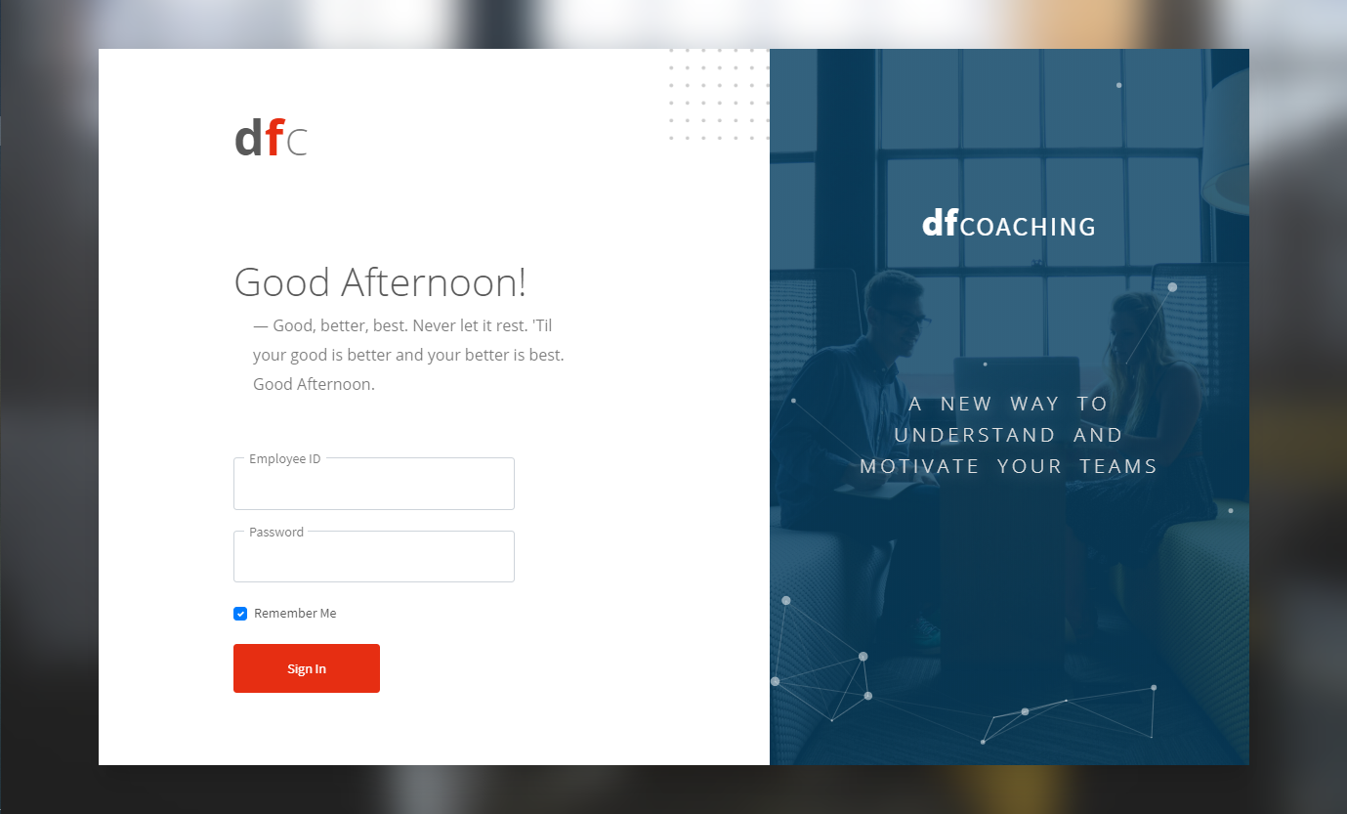
Components Login

Slide 6
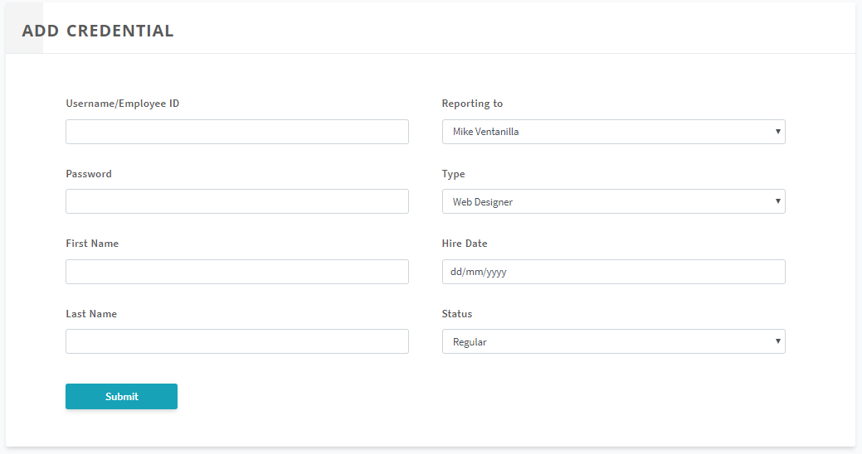
Components Admin Control Panel Add Credential

Slide 7
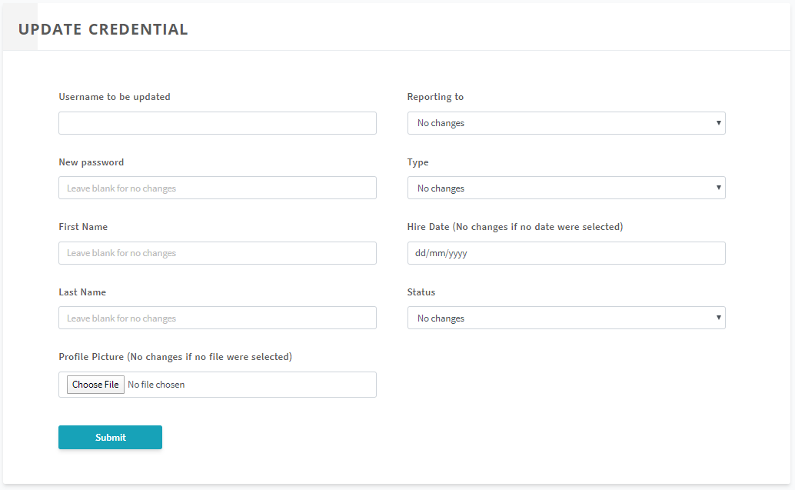
Components Admin Control Panel Update Credential

Slide 8
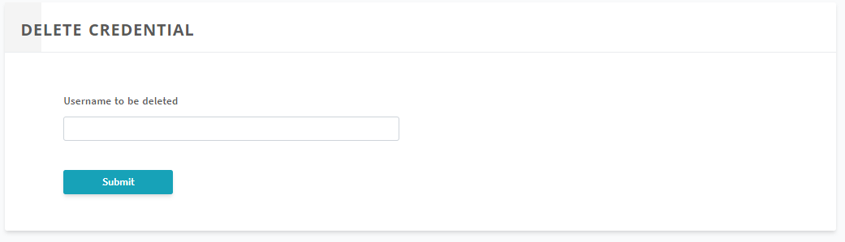
Components Admin Control Panel Delete Credential

Slide 9
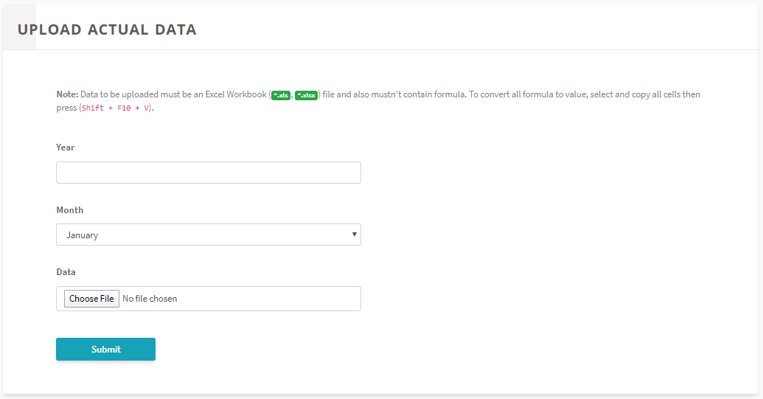
Components Admin Control Panel Upload Data

Slide 10
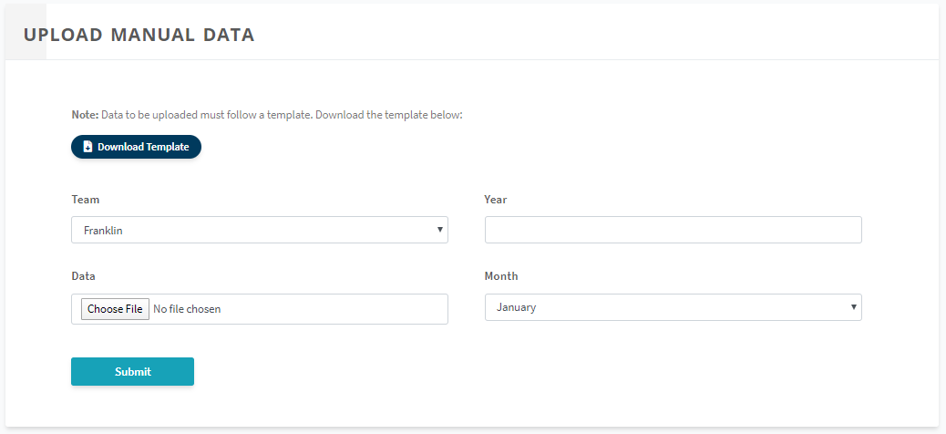
Components Admin Control Panel Upload Manual Data

Slide 11
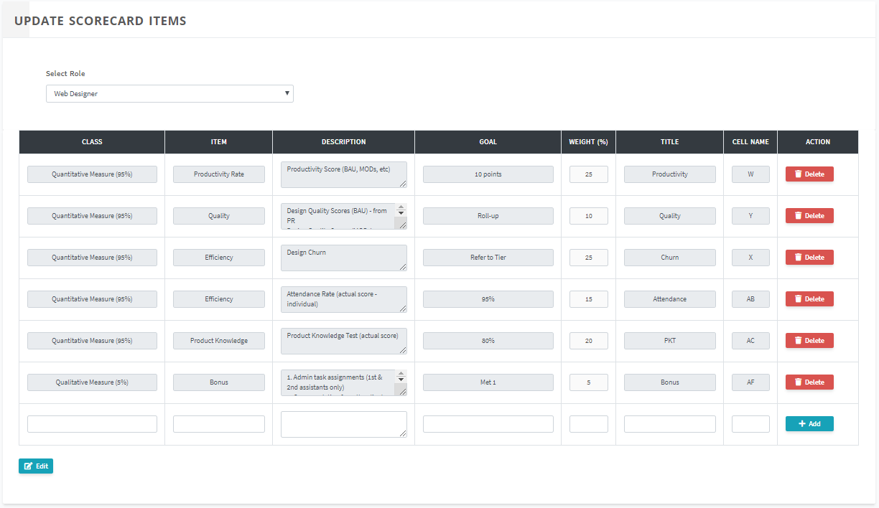
Components Admin Control Panel Update Scorecard Items

Slide 12
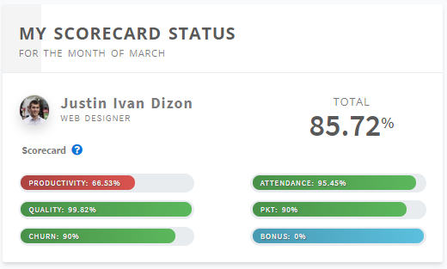
Components Dashboard My Scorecard Status
Displays the current scorecard summary of the agent based on the actual data
(Available only for agents)

Slide 13
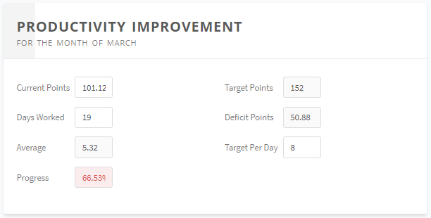
Components Dashboard Productivity Improvement
Lets you simulate your productivity score
Agents can adjust the fields Current Points, Days Worked and Target Per Day
(Available only for agents)

Slide 14
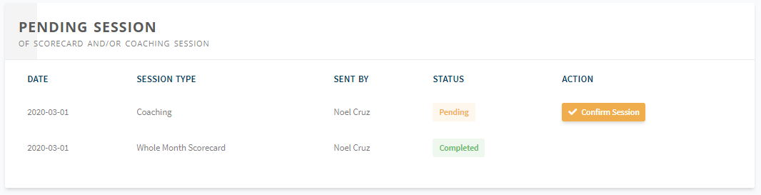
Components Dashboard User Sessions
Lets the user access their pending sessions and view its details and current status
(Available to all roles with different component titles)
Titles
Agent: Pending Session
Supervisor: My Summary
OM & OH: Supervisors Summary

Slide 15
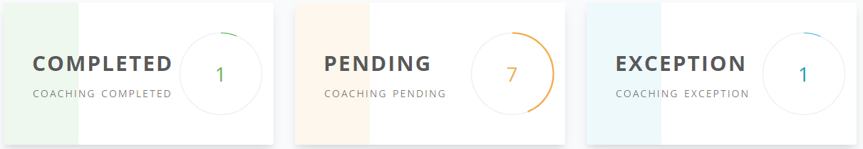
Components Dashboard Counter Cards
Lets the user see the current count of completed sessions, pending sessions and excepted agents this week
(Available only to leaders)

Slide 16
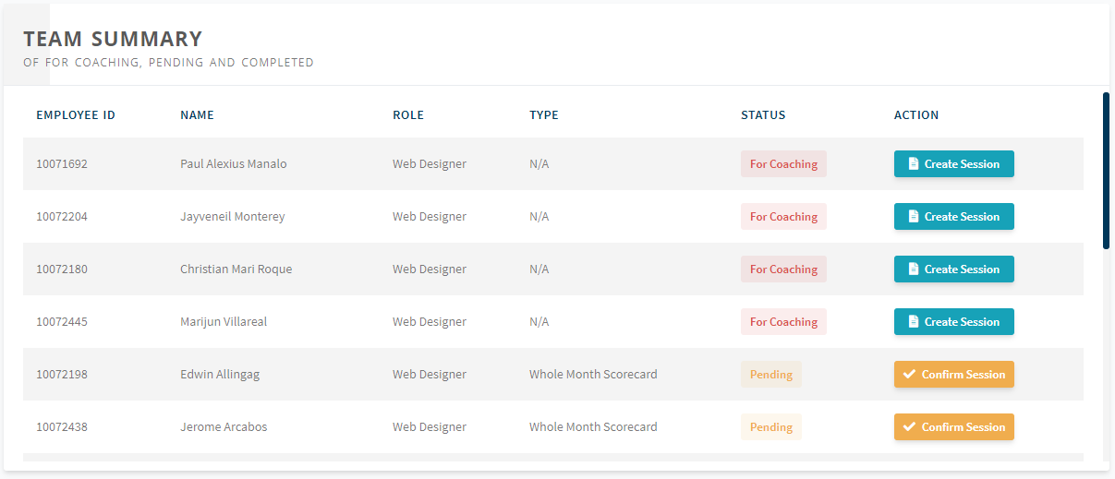
Components Dashboard Team Sessions
Lets the user access team-level pending sessions and view its details and current status
(Available only to leaders with different component titles)
Titles
Supervisor: Team Summary
OM & OH: Teams Summary

Slide 17
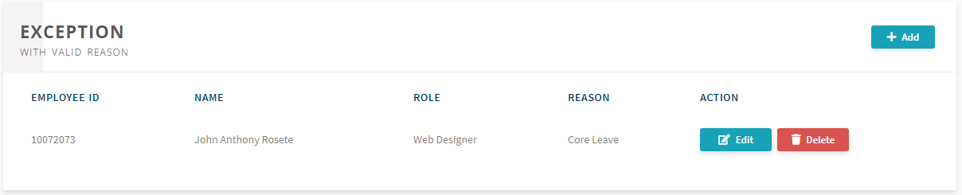
Components Dashboard Exceptions
Lets the user view the agents who are excepted and their reason
(Available only to leaders, only supervisors can except their agents)

Slide 18
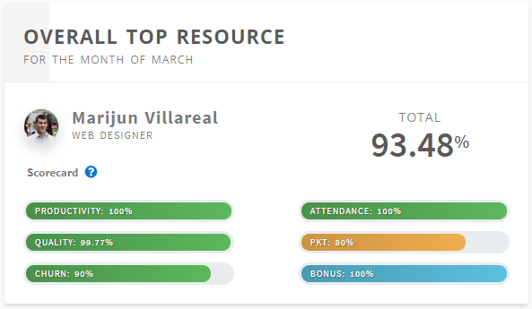
Components Dashboard Overall Top Resource
Lets the user view the current overall top agent on his/her team
(Available only to supervisors)

Slide 19
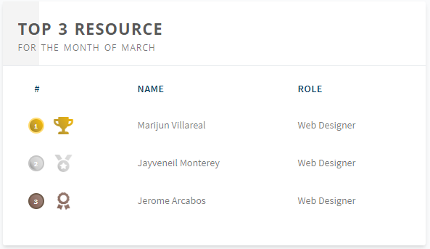
Components Dashboard Top 3 Resource
Lets the user view the current top three agent ranking on his/her team
(Available only to supervisors)

